Slide 1



IOT BASED STREET LIGHT SHORT CIRCUIT DETECTION
ANJALI KASHYAP S (4MN20CS005)
DRUPAD S (4MN20CS015)
GAARGI B (4MN20CS016)
KARTHIK S (4MN20CS023)
Under the guidance of:
Prof. Suhasini
Assistant Professor
Dept. of Computer Science & Engineering
MITT

Slide 2
CONTENTS:
Introduction
Overview with problem statement
Objective and scope
Existing System
Proposed System
Application
Literature Survey
Design
Requirement Specification
Requirement Traceability
Testing
Results

Slide 3
INTRODUCTION:
The consumption of electricity is increasing at much faster rate.
Most of the times consumer’s service interruptions are due to failures in distribution network .
Thus, detecting and locating fault in power line is very necessary for healthy operation of power system.

Slide 4
OVERVIEW WITH PROBLEM STATEMENT:
This project is designed to enhance the efficiency and reliability of street lighting infrastructure by using Internet of Things (IoT) technology.
This system aims to address issue of short circuits in street lights, which can lead to operational disruptions, increased maintenance costs, and energy wastage.
Traditional street lighting systems often face challenges such as delayed detection of short circuits, resulting in prolonged downtime and increased maintenance costs.

Slide 5
OBJECTIVE AND SCOPE:
Develop an IoT-based Street Light System to promptly detect and address short circuits, optimize energy consumption through real-time monitoring and provide a cost-effective, solution for enhanced efficiency, reduced maintenance costs, and minimized environmental impact in street lighting infrastructure.

Slide 6
EXISTING SYSTEM:
Visual Inspection: Human technicians conduct regular visual inspections of electrical infrastructure, such as power lines, street light poles.
Limited Automation: basic automation may be employed, such as remote control of street lights using a central control system.
Manual Control: Street lights are controlled manually by local authorities. They may be turned on or off as needed based on observations or specific requirements.

Slide 7
PROPOSED SYSTEM:
In the proposed concept with the use of wireless sensor network exact location of fault can be diagnosed.
In case of incorrect behaviors , an immediate indication is provided by the microcontroller through the GSM modem.
The GSM modem will receive the signal and send data from distribution side to the substation and to the line patrol staffs as a message in the form of voice alert.

Slide 8
APPLICATIONS:
Urban Infrastructure: Supports smart city initiatives by integrating with other IoT systems for city management.
Commercial and Industrial Facilities: Optimized lighting and energy management in parking lots and industrial areas.
Residential Areas: Enhances safety in residential neighbourhoods by quickly addressing electrical faults.
Rural Areas and Remote Locations: Efficient lighting control in rural communities.

Slide 9
Author and Year | Title | Methodology | Description | Result/Conclusion
M. Vasantha Lakshmi, Y. Rajesh, S. Chandra Sekhar, S.Prabhu Kiran, R. Sai Mahesh. 2020 | IOT Based Automatic Street Light Control and Fault Detection System | Raspberry Pi3, with inbuilt Wi-Fi, uses LDR sensor for automated day/night streetlight control, ensuring energy efficiency. | IoT-based streetlight control and fault detection with Raspberry Pi3 and LDR sensors monitor intensity, alerting faults promptly. | The project improves efficiency and reduces costs and minimizes energy wastage

Slide 10
Author and Year | Title | Methodology | Description | Result/Conclusion
H. P. Khandagale , R.Zambare , P. Pawar, P. Jadhav, P. Patil, S. Mule. 2020 | Street Light Controller With Gsm Technology. | The GSM-based streetlamp system comprises three modules: lamp switching (On/Off), sensor module, and GSM module for control. | Wireless GSM streetlight control with SMS automation, integrating microcontroller, IoT, sensors, GSM, and LDR-regulated smart lighting | System for better control of poorly managed street lamps

Slide 11
Author and Year | Title | Methodology | Description | Result/Conclusion
Ashok Kumar Nanduri, Siva Kumar Kotamraj , G L Sravanthi, Sadhu Ratna Babu, K V K V L Pavan Kumar 2020 | IOT based Automatic Damaged Street Light Fault Detection Management System. | Smart streetlights adjust brightness with IoT and GSM, detecting obstacles and notifying mobile phones for energy conservation and efficient maintenance. | Raspberry Pi program controls streetlights, detects faults with cloud storage, and manages ON/OFF based on LDR-assessed weather conditions for efficient control and fault detection. | Automated streetlight control minimizes human efforts, swiftly identifies and resolves issues in lamps.

Slide 12
Author and Year | Title | Methodology | Description | Result/Conclusion
Prashant Kumar, Shivaraj S Hiremath, G V Sandeep , Santoshkumar Javalagi, Dr. Venkata Siva Reddy 2021 | IOT based Automatic Street Light Control and Fault Detection. | Control the intensity of a lamp based on readings from an IR sensor and an LDR | Automated streetlights use LDR for sunlight control, with fault detection and GSM alerts. Infrared sensors enhance security and energy efficiency | Cost-effective IoT streetlights save energy, need minimal maintenance.

Slide 13
Author and Year | Title | Methodology | Description | Result/Conclusion
Krunal Khobragade, Kundan Gaikwad, Pravin Bhiogade, Akshay Pardhi, Sonali Kharwade 2021 | GSM Based Automatic Street Light Control System. | LDR-controlled streetlights automatically turn off in light and on in darkness, sending GSM notifications. | Energy-efficient system with adaptable LEDs adjusts intensity based on PIR sensor, detects faults, and communicates via GSM for efficient maintenance. | Smart adaptive lighting for energy conservation.

Slide 14
Author and Year | Title | Methodology | Description | Result/Conclusion
Vuyyuru Chandra Sekhar , Padamata Neelima, Tatiparthi Anantha Lakshmi, Sodadasu Siromani 2022 | IOT- Based Smart Streetlight Monitoring System with Fault Detection using GSM. | Smart streetlights use IoT and GSM for adaptive brightness, obstacle tracking, and user-friendly light failure alerts. | Smart streetlights use IoT and GSM to adjust brightness based on conditions, saving energy. An app on ThingSpeak tracks light status, and GSM sends alerts if lights fail, contributing to energy conservation and efficient maintenance. | Improved streetlight efficiency and control for greater effectiveness

Slide 15
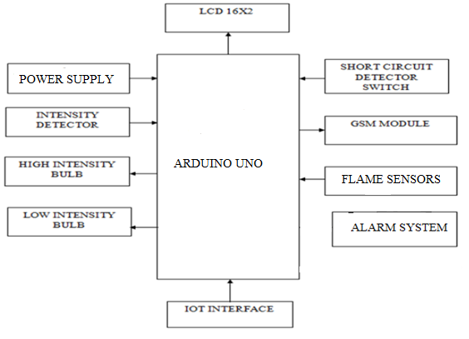
SYSTEM ARCHITECTURE:
Fig : System Architecture

Slide 16
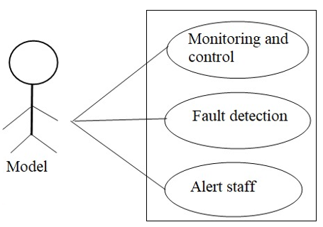
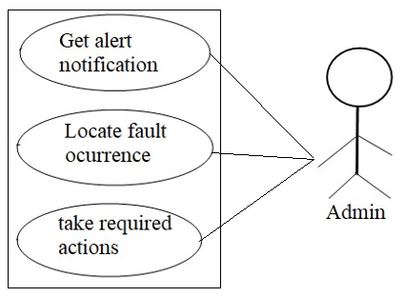
USE – CASE DIAGRAM:
Fig : Use case diagram

Slide 17
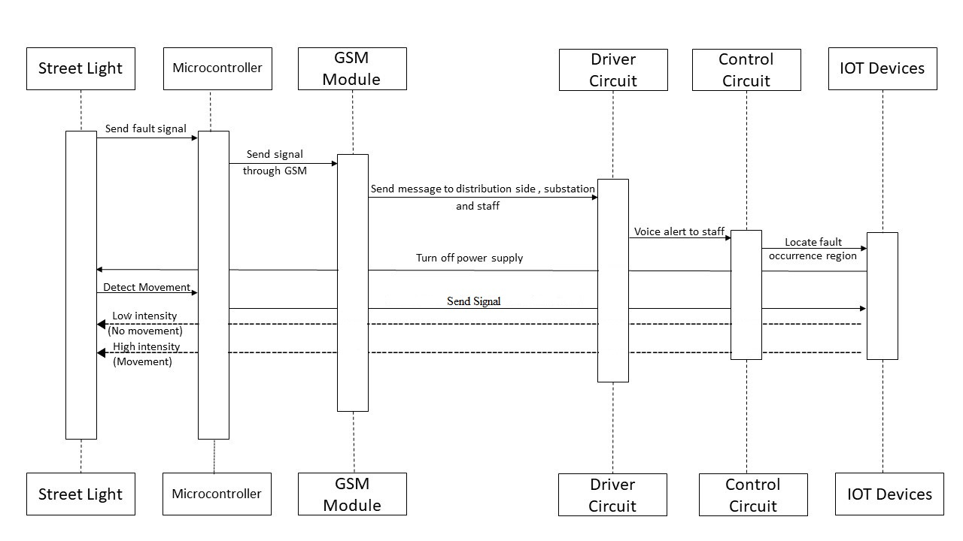
SEQUENCE DIAGRAM:
Fig : Sequence Diagram
Fig : Sequence diagram

Slide 18
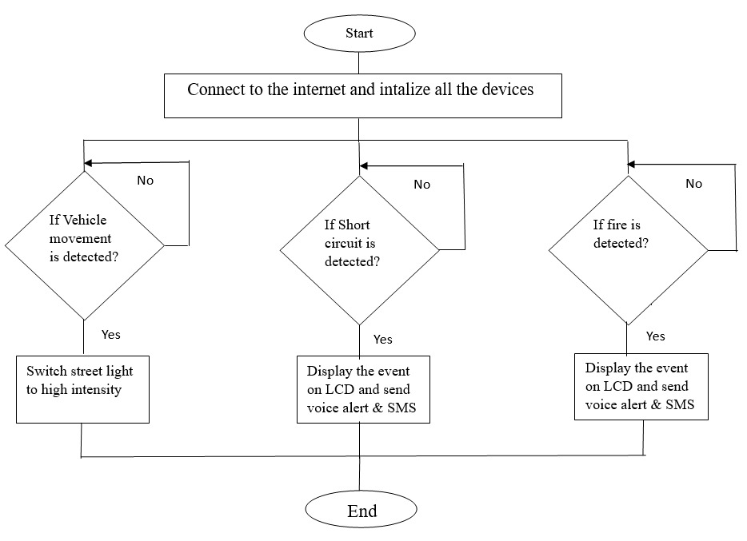
FLOW CHART
Fig.Flow Chart

Slide 19
HARDWARE REQUIREMENTS:
SHORT CIRCUIT DETECTOR SWITCH
GSM MODULE
ESP32
LDR SENSOR
IR SENSOR
LED LIGHTS

Slide 20
SOFTWARE REQUIREMENTS:
EMBEDDED C
ARDUION IDE
BLYNK IoT

Slide 21
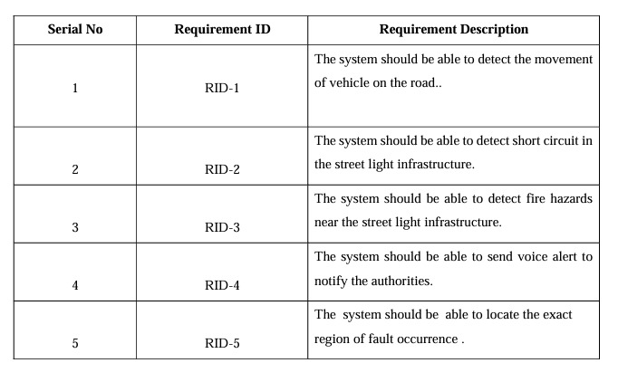
REQUIREMENT TRACEABILITY

Slide 22
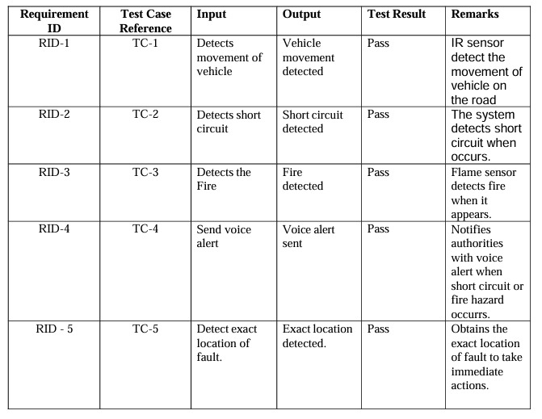
TESTING

Slide 23
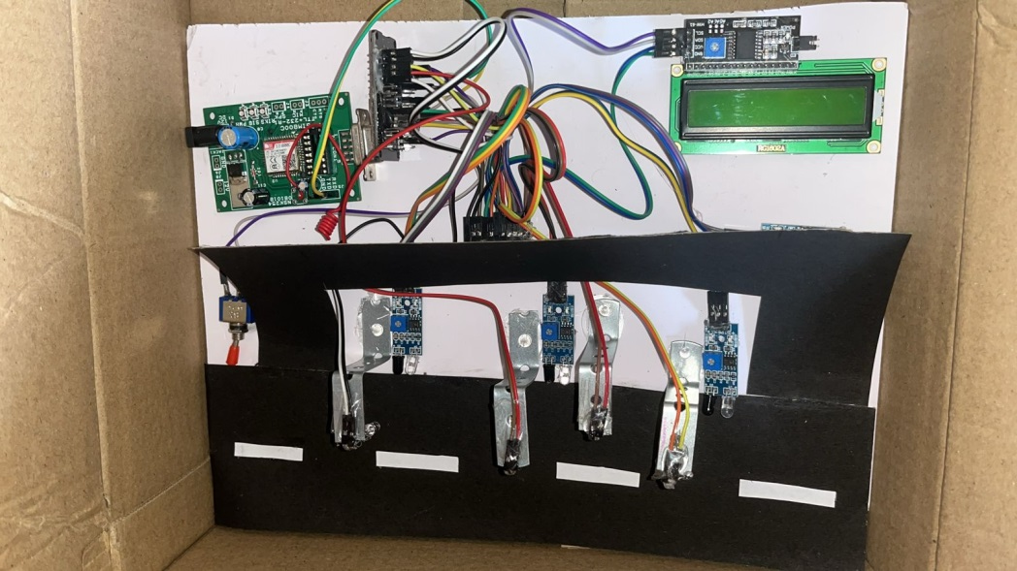
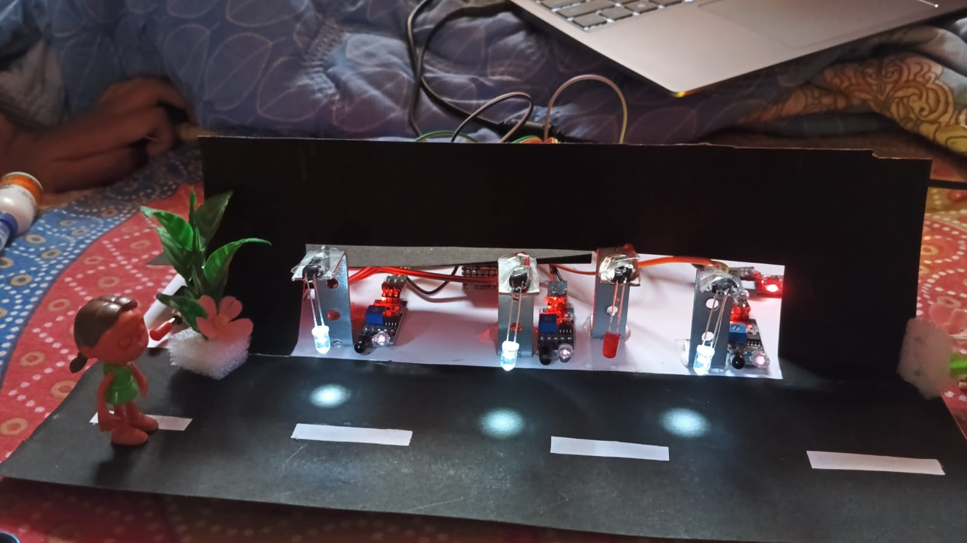
SNAPSHOTS
Fig:Street Light Infrastructure

Slide 24
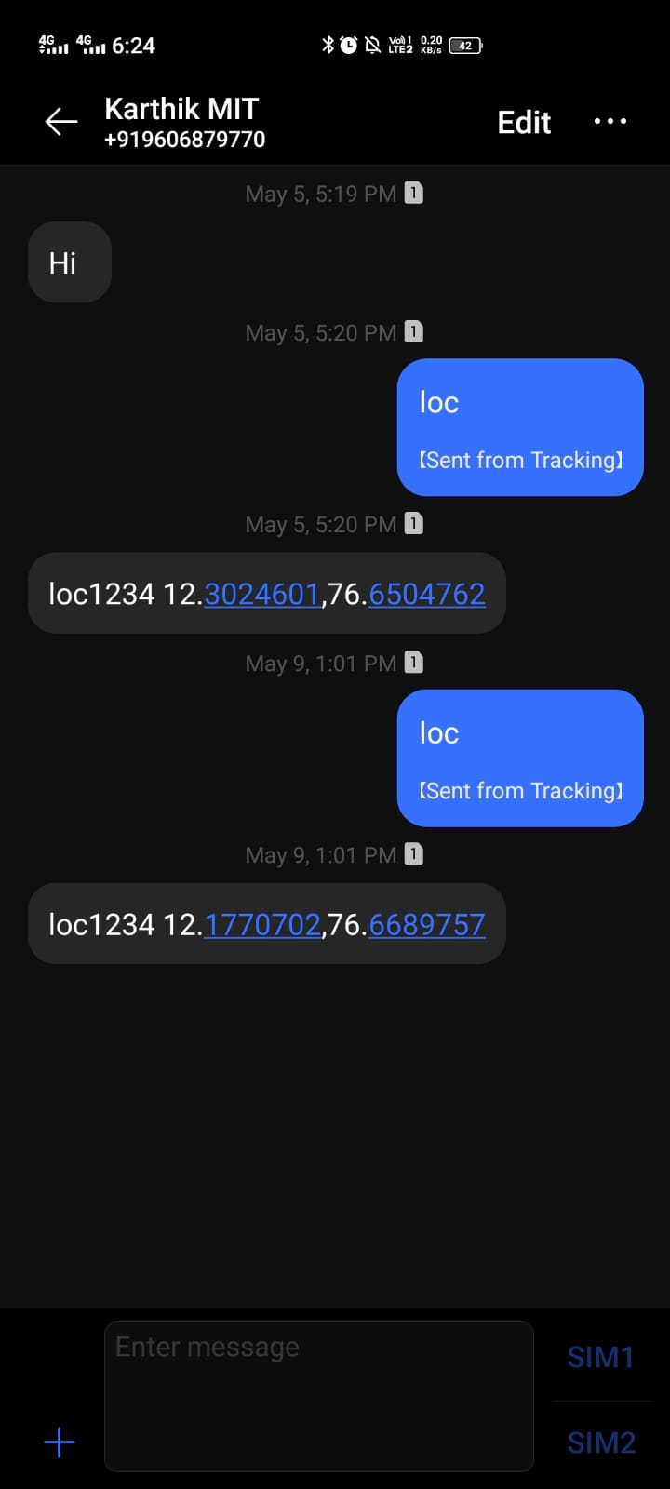
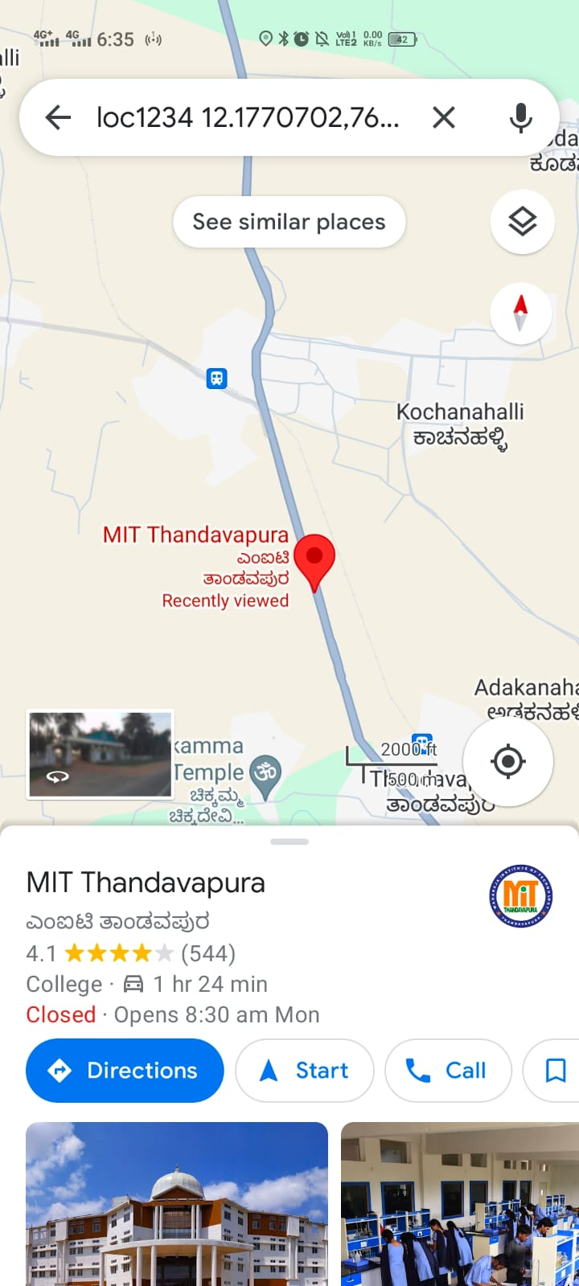
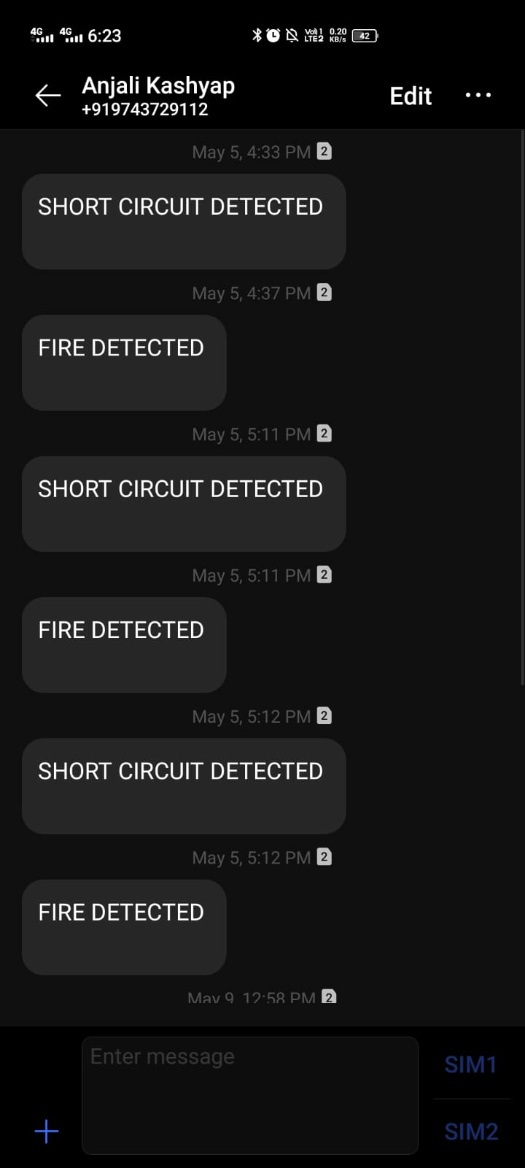
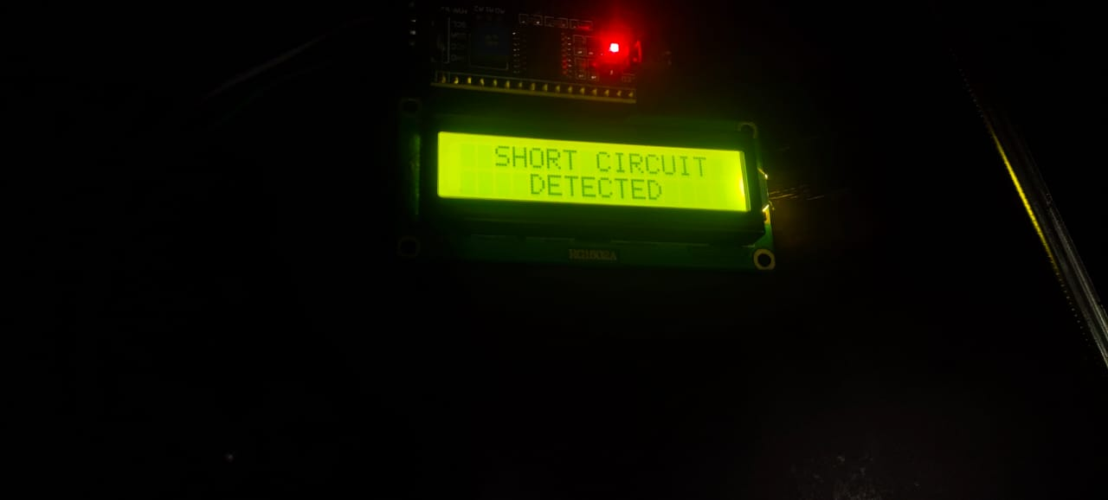
SNAPSHOTS
Fig:Short circuit detected
Fig:Alert Message
Fig:Location of fault

Slide 25

Any Queries!

Slide 26

Thank You Listeners!

